Slide 1
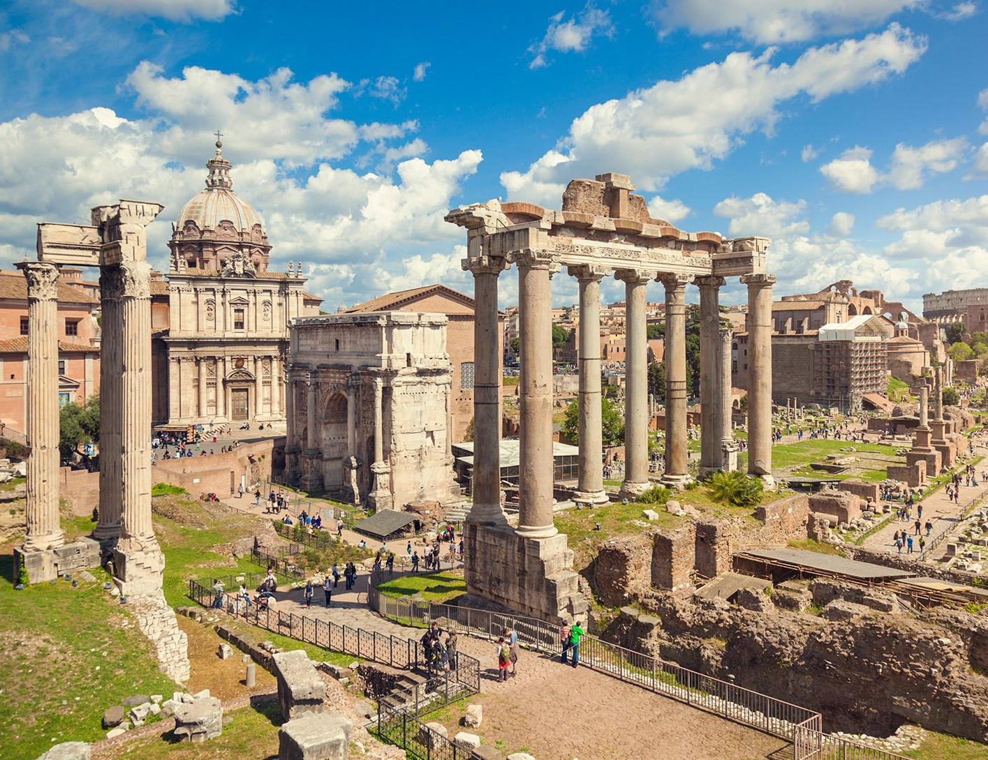
Values, Beliefs, and Traditions
- Describe the values and beliefs of Ancient Rome
Week 4 Lesson 1
Ms Barrie

Slide 2
Ancient Roman religion was a complex system of beliefs and practices that evolved over time, reflecting the changing political, social, and economic circumstances of the Roman Empire. Its roots can be traced back to the early days of the city of Rome, when its inhabitants worshipped a pantheon of gods and goddesses that embodied the forces of nature and the ideals of civic virtue. One of the most distinctive features of Ancient Roman religion was its syncretic character, which meant that it incorporated elements from a wide variety of other religious traditions. This was partly because the Romans were a highly cosmopolitan people, with a vast empire that encompassed many different cultures and religions. As they conquered new territories, they often assimilated the local deities into their own pantheon, creating a rich tapestry of beliefs and practices.

Slide 3

ACTIVITY - Research
Go to: https://www.historyskills.com/classroom/ancient-history/roman-religion-reading/
Complete the Research Booklet provided

